Slide 1

What are some Knowledge Graph Data Models?

Slide 2
Outline
Two Popular Knowledge Graph Data Models
Resource Description Framework (RDF) (Query language: SPARQL)
Property Graphs (Query language: Cypher)
Comparison of RDF and Property Graphs
Comparison of Graph Models with Relational Model
Limitations of Graph Data Models
Summary

Slide 3
Resource Description Framework
Designed to represent information on the web
Standardized by World Wide Web (W3C) Consortium

Slide 4
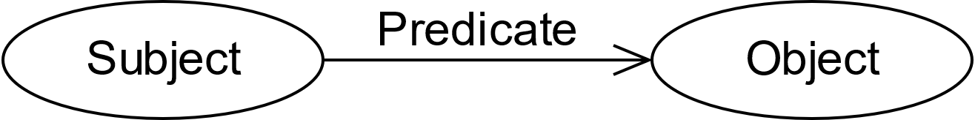
RDF Data Model
Triple is the basic unit of representation
Consists of subject, predicate, and object
art
knows
bob

Slide 5
RDF Data Model
The nodes can be of three types
Internationalized Resource Identifiers (IRI)
Uniquely identifies resources on the web
Literals
A value of certain type (integer, string, etc.)
Blank nodes
A node with no identifier (anonymous)

Slide 6
Internationalized Resource Identifiers
URL: http://www.wikipedia.org
URI: www.wikipedia.org
IRI: https://hi.wikipedia.org/हिन्दी_विकिपीडिया

Slide 7
Internationalized Resource Identifiers
Generalization of Uniform Resource Identifiers
URIs sequence of characters chosen from a limited subset of the repertoire of US-ASCII
Uniform Resource Locator (URL) is a URI that also specifies the method of access
IRIs use characters chosen from Universal Character Set (UCS)
Examples:
URL: http://www.wikipedia.org
URI: www.wikipedia.org
IRI: https://hi.wikipedia.org/हिन्दी_विकिपीडिया

Slide 8
Internationalized Resource Identifiers
<http://example.org/art> <http://xmlns.com/foaf/0.1/knows> <http://example.org/bob>
art
knows
bob

Slide 9
Internationalized Resource Identifiers
<http://example.org/art> <http://xmlns.com/foaf/0.1/knows> <http://example.org/bob>
We can define prefixes
@prefix foaf: <http://xmlns.com/foaf/0.1/>
@prefix ex: <http://example.org/>
ex:art foaf:knows ex:bob
art
knows
bob

Slide 10
Internationalized Resource Identifiers
<http://example.org/art> <http://xmlns.com/foaf/0.1/know> <http://example.org/bob>
We can define prefixes
@prefix foaf: <http://xmlns.com/foaf/0.1/>
@prefix ex: <http://example.org/>
ex:art foaf:knows ex:bob

Slide 11
Literal
A value of certain type
Examples:
ex:bea foaf:age 23
"1"^^xsd:integer
"01"^^xsd:integer

Slide 12
Blank Nodes
Used for representing structured information
exstaff:85740 exterms:address "1501 Grant Avenue, Bedford, Massachusetts 01730" .
exstaff:85740 exterms:address _:art_address
_:art_address exterms:street “1501 Grant Avenue”
_:art_address exterms:city “Bedford”
_:art_address exterms:state “Massachusetts”
_:art_address exterms:zip “01730”

Slide 13
RDF Vocabulary
A set of IRIs to be used in describing the data
RDF graphs are static
By providing suitable vocabulary extension dynamics of data may be captured

Slide 14
RDF Dataset
A collection of RDF graphs with
Exactly one default graph
One or more named graphs
Name can be a blank node or an IRI

Slide 15
Query Language: SPARQL
Simple Protocol and Query Language (pronounced “sparkl”)
Queries can go across multiple sources
Show me on a map the birthplace of people who died in Winterthour
Full-featured query language
Required/optional parameters
Filtering the results
Results can be graphs

Slide 16
Query Language: SPARQL
Example: Who are the persons that art knows?
SELECT ?person
WHERE
<http://example.org/art> <http://xmlns.com/foaf/0.1/knows> ?person
Graph Pattern
?person1
<http://example.org/bob>
<http://example.org/bea>

Slide 17
Query Language: SPARQL
Example: Who are the persons known by the persons that art knows?
SELECT ?person ?person1
WHERE
<http://example.org/art> <http://xmlns.com/foaf/0.1/knows> ?person
?person <http://xmlns.com/foaf/0.1/knows> ?person1
?person | ?person1
<http://example.org/bob> | <http://example.org/cal>
<http://example.org/bob> | <http://example.org/cam>
<http://example.org/bea> | <http://example.org/coe>
<http://example.org/bea> | <http://example.org/cory>

Slide 18
Query Language: SPARQL
PREFIX ex: <http://example.org/art>
PREFIX foaf: <http://xmlns.com/foaf/0.1/
SELECT ?person ?person1
WHERE
ex:art foaf:knows ?person
?person foaf:knows ?person1
?person | ?person1
<http://example.org/bob> | <http://example.org/cal>
<http://example.org/bob> | <http://example.org/cam>
<http://example.org/bea> | <http://example.org/coe>
<http://example.org/bea> | <http://example.org/cory>
Basic graph pattern match

Slide 19
Query Language: SPARQL
@prefix dc: <http://purl.org/dc/elements/1.1/> .
@prefix : <http://example.org/book/> .
@prefix ns: <http://example.org/ns#> .
:book1 dc:title "SPARQL Tutorial" .
:book1 ns:price 42 .
:book2 dc:title "The Semantic Web" .
:book2 ns:price 23 .
PREFIX dc: <http://purl.org/dc/elements/1.1/>
SELECT ?title
WHERE { ?x dc:title ?title
FILTER regex(?title, "^SPARQL")
}
title
“SPARQL Tutorial”

Slide 20
Query Language: SPARQL
@prefix dc: <http://purl.org/dc/elements/1.1/> .
@prefix : <http://example.org/book/> .
@prefix ns: <http://example.org/ns#> .
:book1 dc:title "SPARQL Tutorial" .
:book1 ns:price 42 .
:book2 dc:title "The Semantic Web" .
:book2 ns:price 23 .
PREFIX dc: <http://purl.org/dc/elements/1.1/>
PREFIX ns: <http://example.org/ns#>
SELECT ?title ?price
WHERE { ?x ns:price ?price .
FILTER (?price < 30.5)
?x dc:title ?title . }
?title | ?price
“The Semantic Web” | 23

Slide 21
Query Language: SPARQL
Instead of SELECT, we can use CONSTRUCT
Returns a graph
Queries can contain more than one graph pattern
Eliminate duplicates, total number of results

Slide 22
Outline
Two Popular Knowledge Graph Data Models
Resource Description Framework (RDF) (Query language: SPARQL)
Property Graphs (Query language: Cypher)
Comparison of RDF and Property Graphs
Comparison of Graph Models with Relational Model
Limitations of Graph Data Models
Summary

Slide 23
Property Graph Data Model
Used by many graph databases
General graph data
Do not require a predefined schema
Optimize graph traversals

Slide 24
Property Graph Data Model
Nodes, relationships and properties
Each node and a relationship has a label and set of properties
Properties are key value pairs
Keys are strings, values can be any data types
Each relationship has a direction

Slide 25
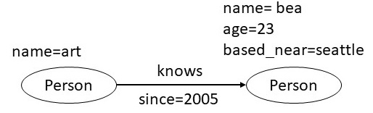
Property Graph Data Model
Nodes, relationships and properties
Each node and a relationship has a label and set of properties
Properties are key value pairs
Keys are strings, values can be any data types
Each relationship has a direction

Slide 26
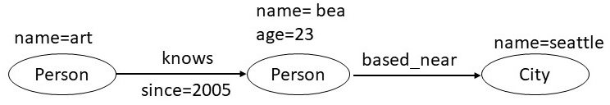
Property Graph Data Model
Nodes, relationships and properties
Each node and a relationship has a label and set of properties
Properties are key value pairs
Keys are strings, values can be any data types
Each relationship has a direction

Slide 27
Query Language: Cypher
Query language for querying graph data
Being considered for adoption as an ISO Standard
Supports CRUD operations
Create, read, update, delete

Slide 28
Query Language: Cypher
Which people does art know?
MATCH (p1:Person {name: art}) -[:knows]-> (p2: Person)
RETURN p2

Slide 29
Query Language: Cypher
Which people does art know since 2010?
MATCH (p1:Person {name: art}) -[:knows {since: 2010}]-> (p2: Person)
RETURN p1, p2

Slide 30
Query Language: Cypher
Which people does art know since 2010?
MATCH (p1:Person) -[:knows {since: Y}]-> (p2: Person)
WHERE Y <= 2010
RETURN p1, p2
WHERE clause can be used to specify a variety of filtering constraints

Slide 31
Query Language: Cypher
Constructs for
Counting
Grouping
Aggregating
Min/Max

Slide 32
Outline
Two Popular Knowledge Graph Data Models
Resource Description Framework (RDF) (Query language: SPARQL)
Property Graphs (Query language: Cypher)
Comparison of RDF and Property Graphs
Comparison of Graph Models with Relational Model
Limitations of Graph Data Models
Summary

Slide 33
RDF and Property Graphs
RDF supports several additional layers
RDF Schema, Web Ontology, etc.
Basic differences
Property graph model supports edge properties
Property graph model does not require IRIs
Property graph model does not support blank nodes

Slide 34
Reification in RDF
Suppose we wish to specify the provenance of a triple
exproducts:item10245 exterms:weight "2.4"^^xsd:decimal
We wish to state who took the above measurement
In a property graph we would do it using an edge property

Slide 35
Reification in RDF
Reification Vocabulary
rdf:type, rdf:Statement
rdf:subject
rdf:predicate
rdf:object

Slide 36
Reification in RDF
Reification Vocabulary
rdf:type rdf:Statement
rdf:subject
rdf:predicate
rdf:object
exproducts:item10245 exterms:weight "2.4"^^xsd:decimal
exproducts:triple12345 rdf:type rdf:Statement .
exproducts:triple12345 rdf:subject exproducts:item10245 .
exproducts:triple12345 rdf:predicate exterms:weight .
exproducts:triple12345 rdf:object "2.4"^^xsd:decimal .
exproducts:triple12345 dc:creator exstaff:85740 .

Slide 37
Translating Property Graphs into RDF
Property Graph
Node properties
Edges
Edge properties
RDF
Triples
Triples
Reified edges + Triples

Slide 38
Translating Property Graphs into RDF
Property Graph
Subject and object become property nodes with predicates as the edges between those nodes
RDF
Triples

Slide 39
Translating Property Graphs into RDF
Property Graph
Subject and object become property nodes with predicates as the edges between those nodes
Create new property nodes only for those nodes that are IRIs or blank nodes
Literals become node properties
RDF
Triples
Triples

Slide 40
RDF and Property Graphs
RDF supports several additional layers
RDF Schema, Web Ontology, etc.
Basic differences
Property graph model supports edge properties
Property graph model does not require IRIs
Property graph model does not support blank nodes

Slide 41
Graph Model and Relational Model
Graphs are easier to understand
Relational schemas can be visualized
Graph queries are more compact and faster
Translator from graph queries to relational queries can be written
Graph systems are optimized for traversal queries

Slide 42
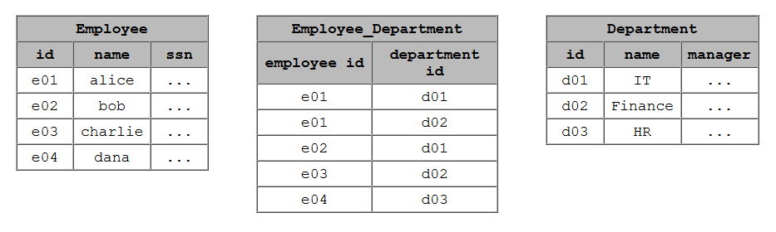
Example

Slide 43
Example
id=e01
name=alice
ssn=…
id=d01
name=IT
manager=…
Employee
works_in
Department

Slide 44
Example
List the employees in the IT Department
SELECT name FROM Employee
LEFT JOIN Employee_Department
ON Employee.Id = Employee_Department.EmployeeId
LEFT JOIN Department
ON Department.Id = Employee_Department.DepartmentId
WHERE Department.name = "IT"

Slide 45
Example
List the employees in the IT Department
SELECT name FROM Employee
LEFT JOIN Employee_Department
ON Employee.Id = Employee_Department.EmployeeId
LEFT JOIN Department
ON Department.Id = Employee_Department.DepartmentId
WHERE Department.name = "IT"
MATCH (p:Employee) -[:works_in]-> (d:Department)
WHERE d = "IT"
RETURN p

Slide 46
Mapping Graph Model to Relational Model
Provide two relational tables
A table that represents node properties as a triple
A table that represents edge properties as four tuples

Slide 47
Mapping Graph Model to Relational Model
Provide a translator from graph queries to relational queries
Incorporate optimizations in the translator
Can optimize queries across the graph data and legacy data in relational systems
Graph Queries
Translator/Optimizer
Graph
Data
Legacy Relational
Data

Slide 48
Limitations of the Graph Model
Triples are not always sufficient
For example, the ternary relationships such as between
Time series data is naturally modeled in relations
Evolving population of a country over a period of time

Slide 49
Summary
RDF/SPARQL and Property Graph / Cypher are common graph data models in use today
RDF addresses the need to model information on the web, while Property Graphs are used as a model in general graph databases
Translations exist between RDF and property graph models
Translations also exist from graph models to relations
Unique features of graph models
More compact queries
Optimized for traversals
Graphical visualization

